Slide 1



Community College Summit 2022
Susquehanna Valley Community Education Partnership
October 7, 2022
www.pacommunitycolleges.org
www.facebook.com/pacommunitycolleges | @pacommunitycoll
Updated September 2022

Slide 2

Pennsylvania’s
Community Colleges
15 community colleges
28 campuses and 54 leased
or partner sites
More than a quarter of a
million students annually
From every county in
the Commonwealth

Slide 3





Pennsylvania Community College
Student Demographics (2021)
63% Female
37% Male
Average Age: 25
60% of Credits Earned are Online
42% Minorities
4,000+ Veterans
69% Part-Time
31% Full-Time

Slide 4



Paying for Their Education
In 2020-21 more than 70,000 credit
students received financial aid
PA State Grant Awards: 18,665 awards totaling $22.7M in 2020-21
PA community college students received over $444.5M in financial aid awards in FY 2017-18
Pell Grants: 56,010 recipients received $189.6M in 2017-18
In 2017-18, the average Pennsylvania community college Pell recipient received $3,174 in aid
Who receives financial aid (2018):
45% of all credit students
  71% of full-time credit students
  41% of part-time students
Where they come from (2018):
65% from households earning below PA median
50% earn less than $30,000 per year

Slide 5

What Are They Studying?
By the numbers (2021):
40% STEM-H Programs
76% aligned with
High Priority Occupations
Onward and Upward (2021):
31,000+ transfer every year
Laying the Foundation for Success (2021):
More than 18,000
dual enrollment students

Slide 6



PA Community Colleges Awarded
16,403 total awards in 2020-21
  40% in STEM-H in 2020-21
13,264 associate degrees in 2020-21
1,700 associate degrees in Nursing
during 2017-18 academic year
  NCLEX first-time pass rate
    PA community colleges: 91%
    Nationwide: 88%

Slide 7

Statewide Economic Impact (2016-17)
Employ 25,000 individuals statewide
  Adding $679M to the Commonwealth’s economy
Students and alumni contributed $13.6B in additional income in FY16-17
Net Present Value (NPV) of tax revenue
of students = $1.6B
Saves PA taxpayers millions through reduced demand on government-funded services

Slide 8

Regional Economic
Impact
Montgomery County Community College
Students gained $4.40 in lifetime earnings, an average rate of return of 16.9%
Taxpayers gained $2.20 in added tax revenue and public sector savings, an average rate of return of 5.0%
Generated $674.3 million in total income in regional economy in 2020-21
Supported 7,882 total jobs (1,260 at the college)
(source: EMSI/burningglass, June 2022)

Slide 9
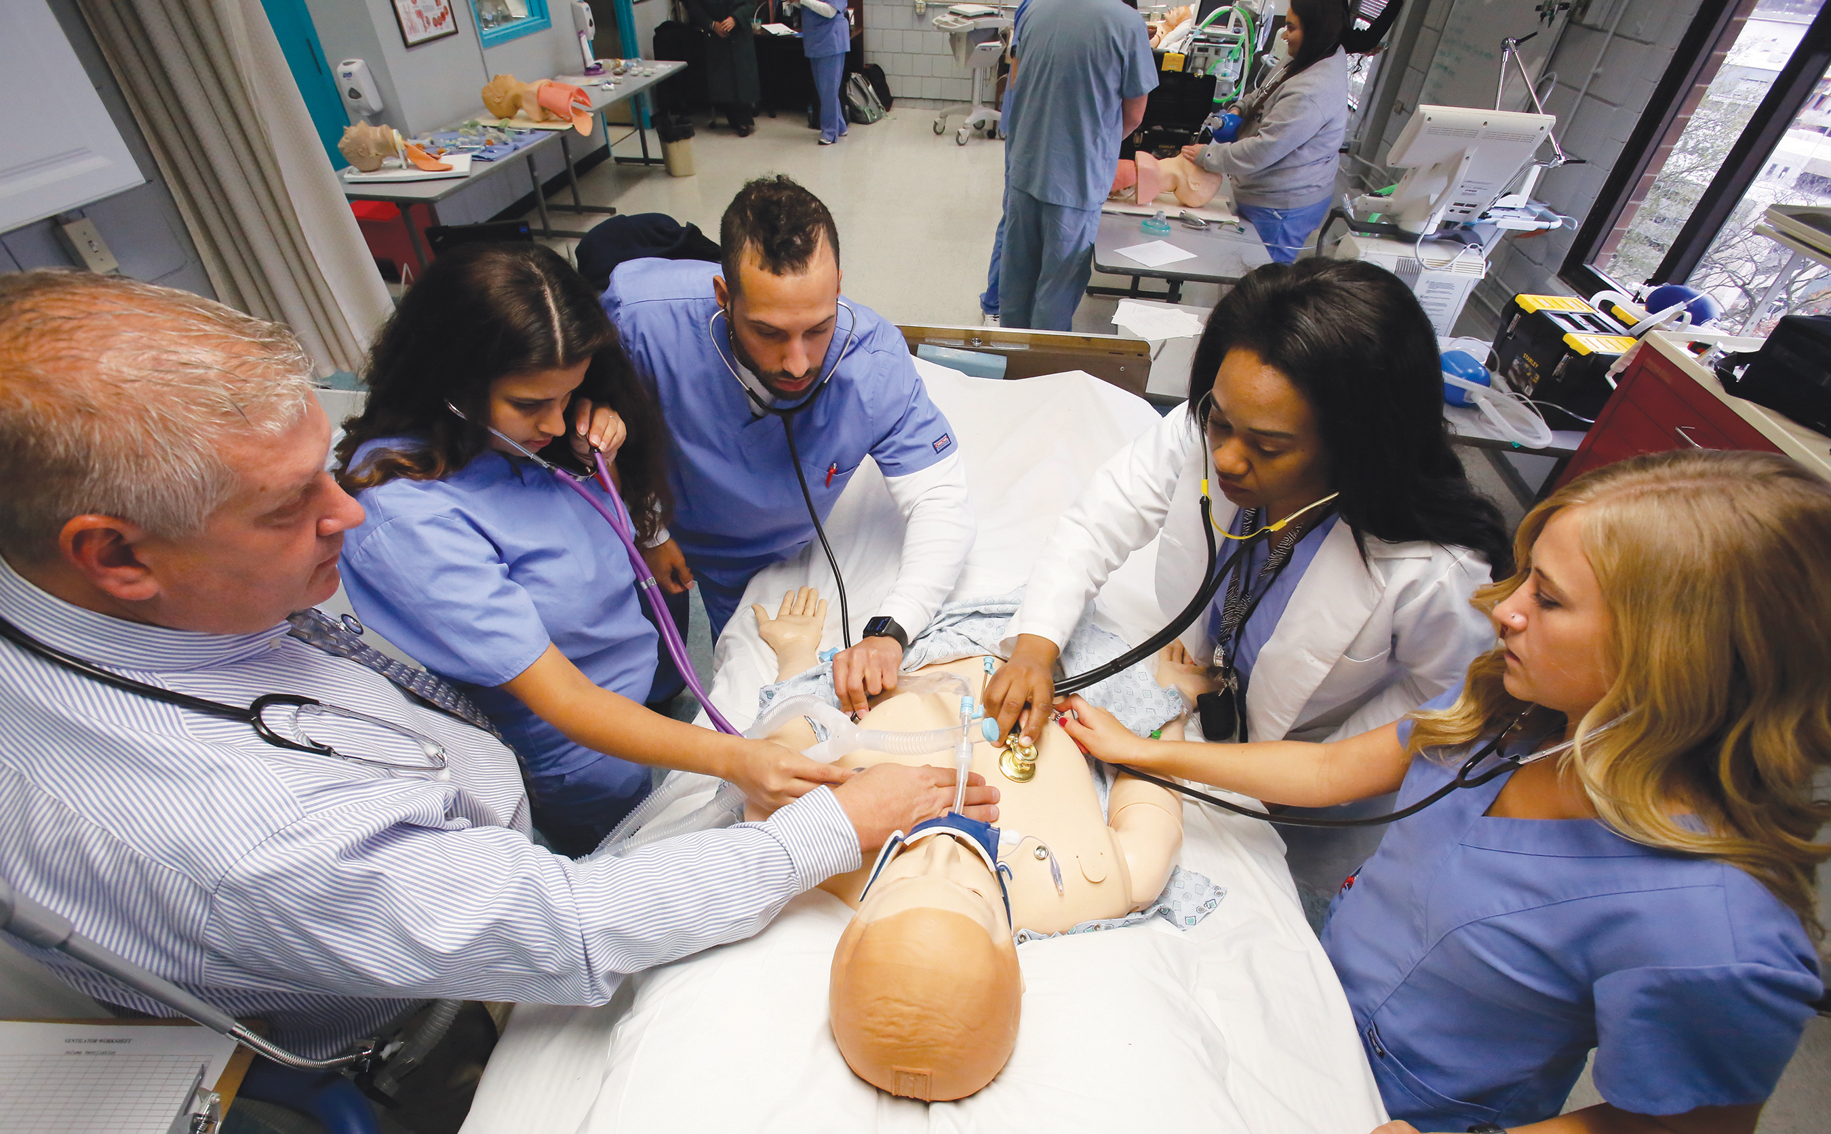
Regional Economic
Impact
Community College of Allegheny County
Students gained $4.70 in higher future earnings for every dollar invested in their education for an average annual rate of return of 19.7%
Added $1.3 billion in income to Allegheny County economy
Supported 15,705 jobs in 2019-2020
Taxpayers gained $2.50 in added tax revenue and public sector savings, an average rate of return of 8.2%
(source: Community College of Allegheny County)

Slide 10
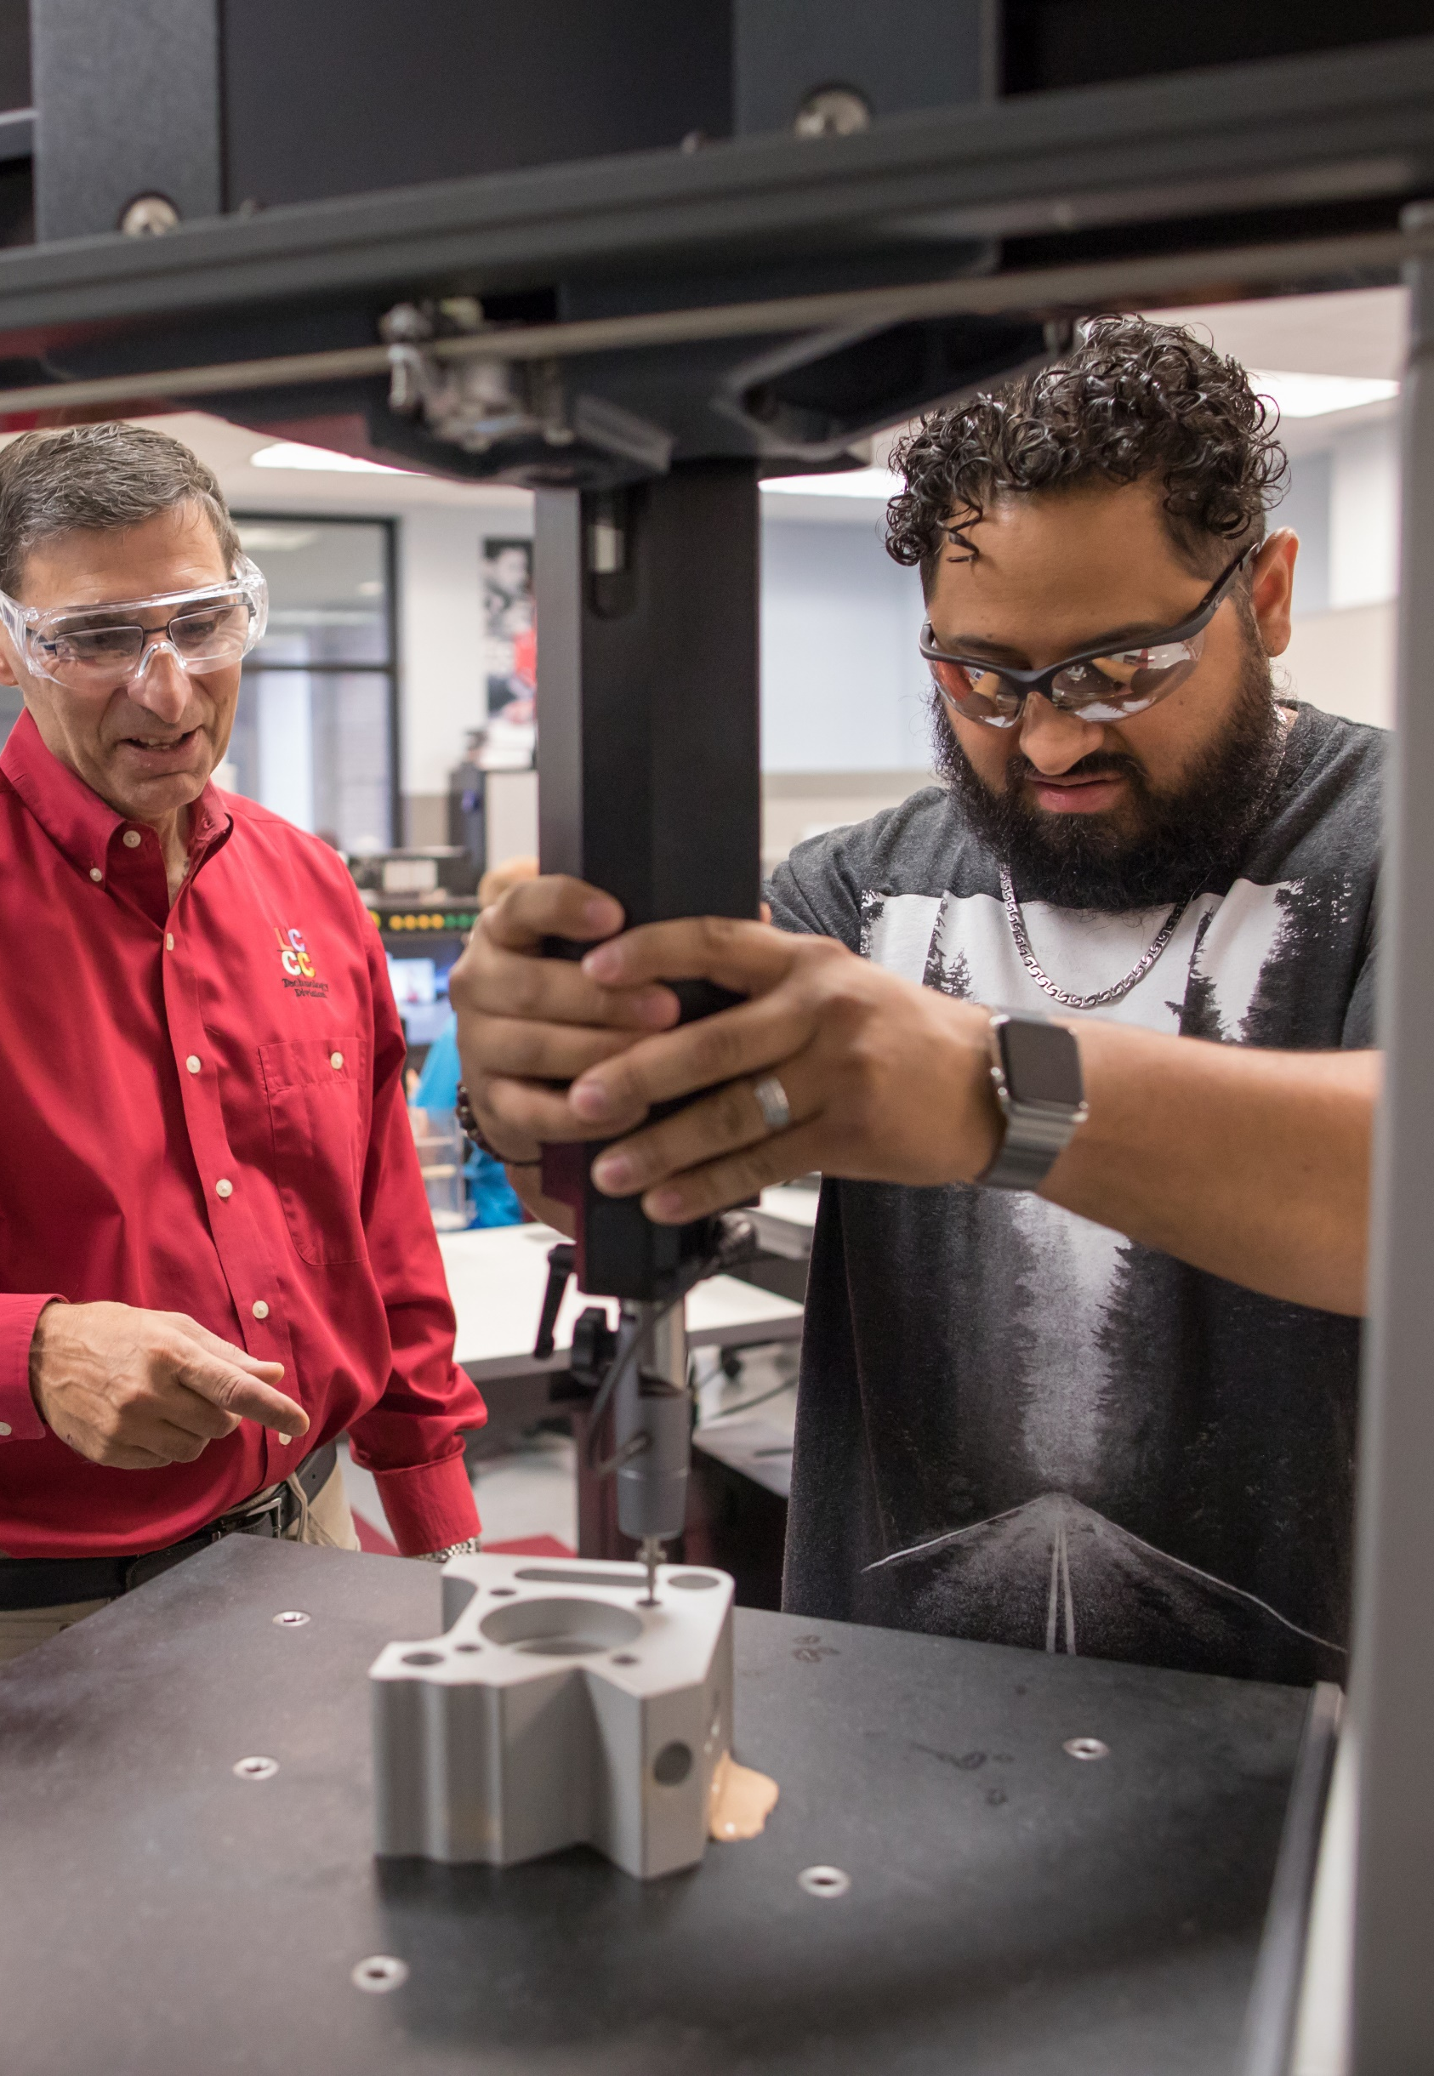
Regional Economic
Impact
Lehigh Carbon Community College
Students gained $4.70 in lifetime earnings, an average rate of return of 20.8%
Taxpayers gained $3.80 in added tax revenue and public sector savings, an average rate of return of 10%
Generated $230.5 million in total income in regional economy in 2019-2020
Supported 3,535 total jobs (825 at the college)
(source: EMSI/burningglass, March 2022)

Slide 11

COVID-19 Impact
Pennsylvania’s community colleges reimagined the delivery of postsecondary education during the COVID-19 pandemic and made every effort to mitigate risk and keep their campuses safe.
There is a significant difference in how colleges operate in October 2022 as compared to March 2020.
Colleges continue to adjust to:
changes in levels of student preparedness for postsecondary study
enrollment declines
changing enrollment patterns
need for support services
employer needs
workforce challenges

Slide 12
Enrollment by Sector (2018 Data)

Slide 13
Community College Operating Appropriation
Operating Appropriation $
Fiscal Year
* FY 2021-22 Per Act 26, the entire amount of operating appropriation increase is to be distributed to the ECCC

Slide 14
Community College Capital Appropriation
Capital Appropriation $
Fiscal Year
*FY 2021-22 The entire amount of capital appropriation increase is to be distributed to the ECCC

Slide 15
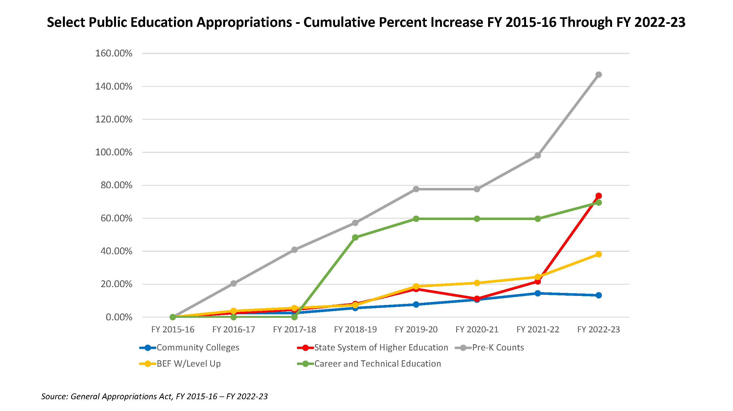
PA Higher Education Funding

Slide 16
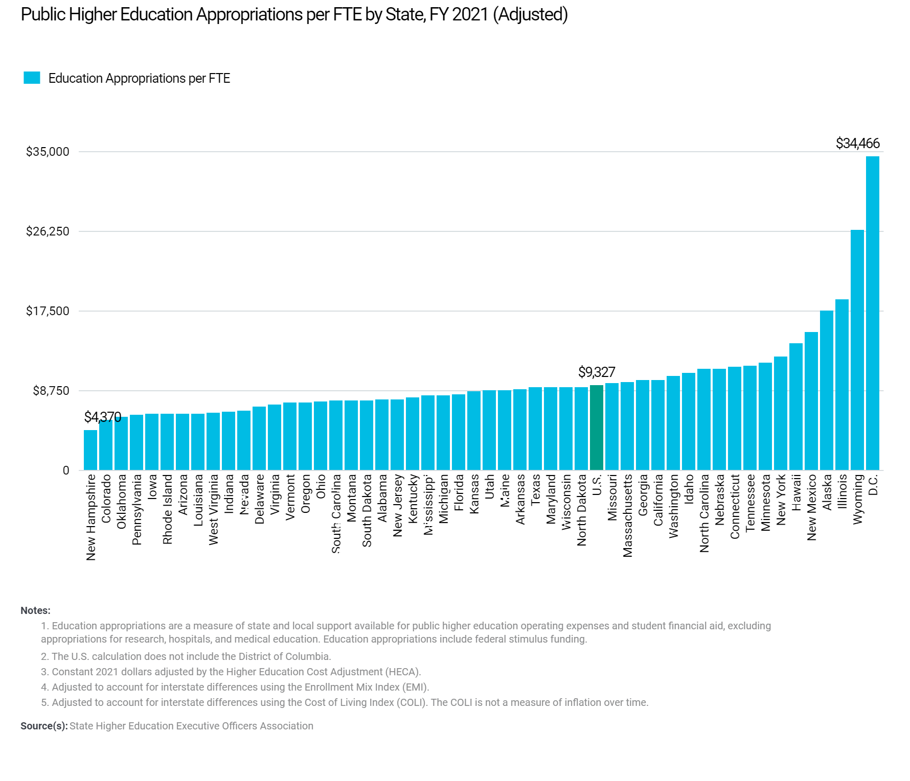
$$6,097

Slide 17
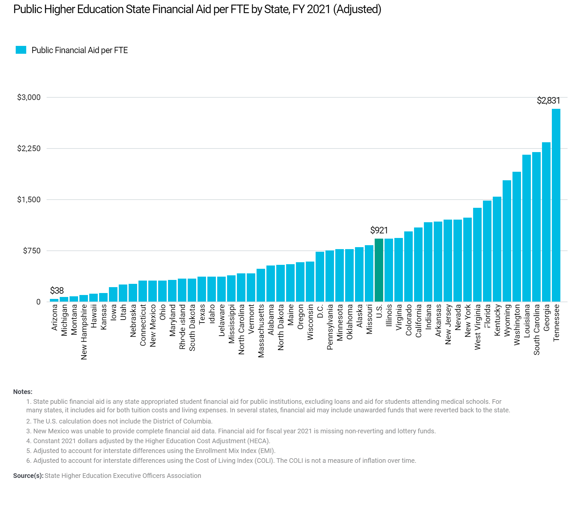
$$748

Slide 18

Student Debt
Pennsylvania has one of the highest levels of student debt in the nation.
Average debt for the Class of 2020 ranged from $18,350 in Utah to $39,950 in New Hampshire. In Pennsylvania it was $39,375, the third highest average debt in the country.
(source: the Institute for College Access & Success, November 2021)
The national average debt for community college students ranged from $7,350 in Connecticut to $25,249 in Utah with a national average of $13,089.
For public community colleges the average is $11,308. In Pennsylvania it was $13,000.
(source: Community College Review)
Many community college students at Commission institutions graduate debt-free!
  For Example: 60% of BC3 recent graduates are debt free

Slide 19

Federal Issues
Increase the Maximum Pell Grant
End of Taxation of Pell Grants
Enact Pell Grant Eligibility for Short Term Workforce Education Programs
Reauthorize the Trade Adjustment Assistance Program
Other federal priorities are available on the American Association of Community College’s website (www.aacc.nche.edu) under “Advocacy” tab

Slide 20

Looking to the Future… New Possibilities
for Pennsylvania Students!
New Programs
80 new programs for 2022-2023 including:
cyber security
cloud computing
truck service technology
welding
fire training
New Partnerships
Drexel Promise
RACC & Commonwealth University
Luzerne County Community College & Alvernia University
Community College of Philadelphia & Toyota

Slide 21
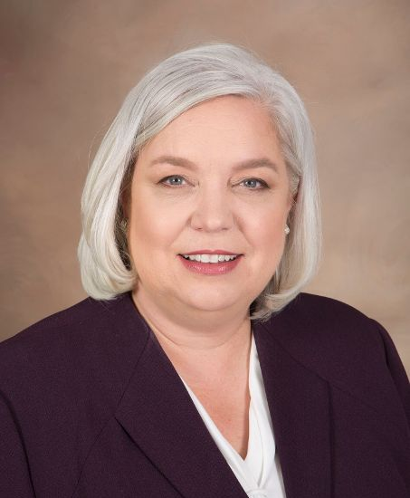
Q&A and Presenter Information
Elizabeth A. Bolden
President & CEO
Pennsylvania Commission
for Community Colleges
ebolden@pacommunitycolleges.org
717-232-7584
www.pacommunitycolleges.org
www.facebook.com/pacommunitycolleges | @pacommunitycoll
Updated September 2022

Slide 22

Thank you!
www.pacommunitycolleges.org
www.facebook.com/pacommunitycolleges | @pacommunitycoll
Updated September 2022

