Slide 1


The Economic Impact of the Proposed
Susquehanna Valley Community College
ANALYSIS OF THE ECONOMIC IMPACT FROM FY 2022 TO FY 2032

Slide 2
Emsi & Higher Education Institutions
18+ years working with higher education institutions
2,000+ economic impact studies completed
1.2M students used Emsi’s career pathways tool last year
9 of 10 2019 Aspen Prize finalists are Emsi customers

Slide 3

What is an ECONOMIC IMPACT ANALYSIS?
Measures how an event or institution affects the regional economy
Short-run capital spending impact
Long-run operations spending impact
Long-run student spending impact
Long-run alumni impact

Slide 4
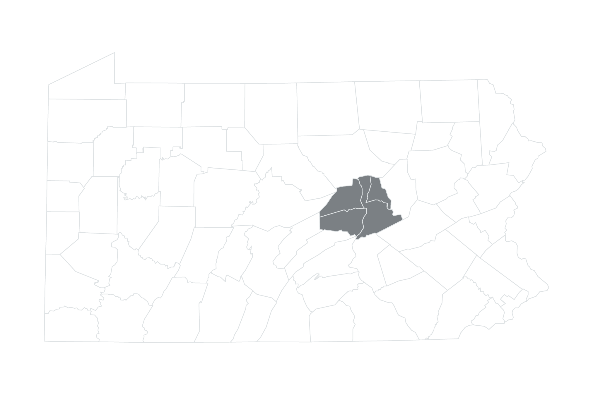
About the NUMS
Northumberland, Union, Montour, and Snyder Counties
Average earnings by education level
$7.9 billion
103,960
Total Gross Regional Product (GRP)
Total Jobs

Slide 5
Proposed Susquehanna Valley Community
College projections
$13.1 million
80
Total capital funding
Projected number of employees
2022
$4.9 million
First year of enrollment
Projected annual payroll/benefits
3,000
$7.9 million
Projected annual number of students
Projected annual tuition and fees

Slide 6
Overview of results
$78.5 million
Total income added to the NUMS
from FY 2022 to FY 2032 (present value)
$16.7 million
Long-run annual added income
to the NUMS economy
2.9 years
Breakeven point of impacts covering costs of construction and additional operational costs (FY 2024)

Slide 7

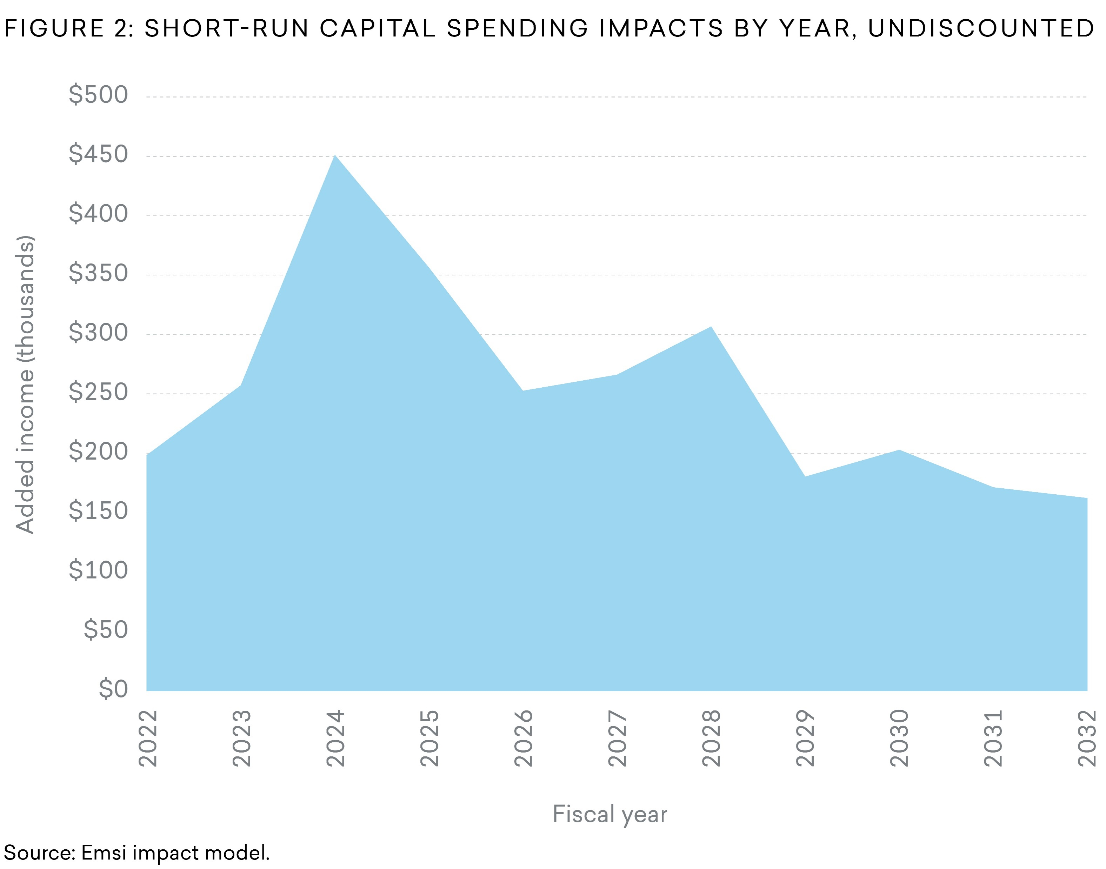
SHORT-RUN CAPITAL SPENDING IMPACT
FY 2022 – FY 2032
Capital spending + ripple effects
Short-run capital spending impacts by year, undiscounted
$2.6 million
Added regional income
All results measured in income, not sales. Results are net of counterfactual scenarios.

Slide 8

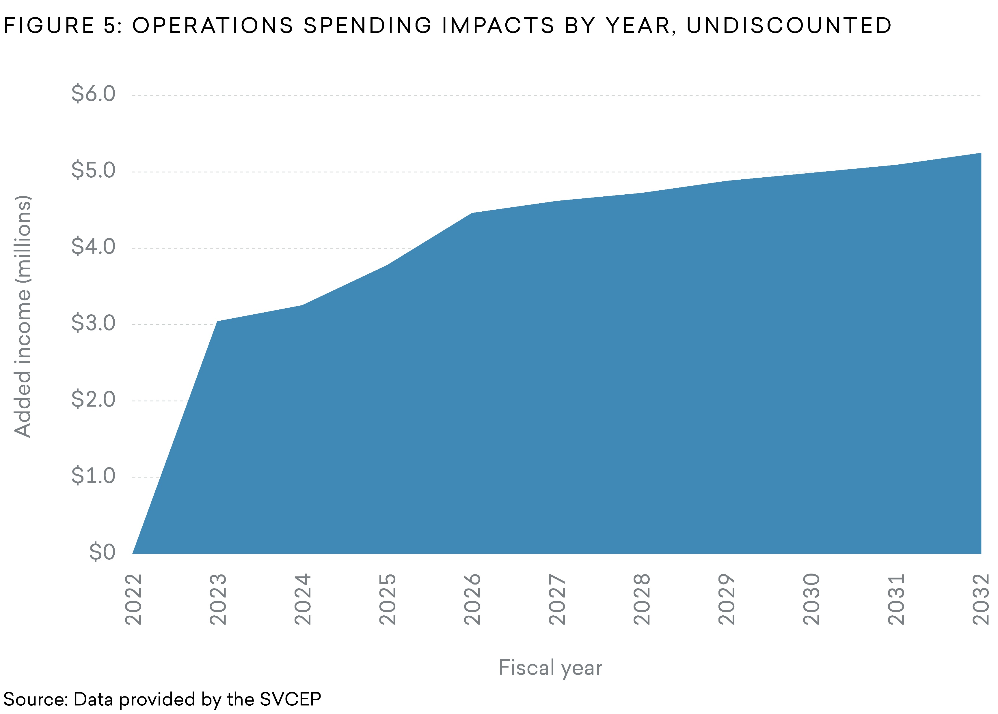
LONG-RUN OPERATIONS SPENDING IMPACT
FY 2022 – FY 2032
The proposed college’s payroll and other spending + ripple effects
Long-run operations spending impacts by year, undiscounted
$39.7 million
Total added regional income
$5.3 million
Annual added regional income
(after stabilized)
All results measured in income, not sales. Results are net of counterfactual scenarios.

Slide 9

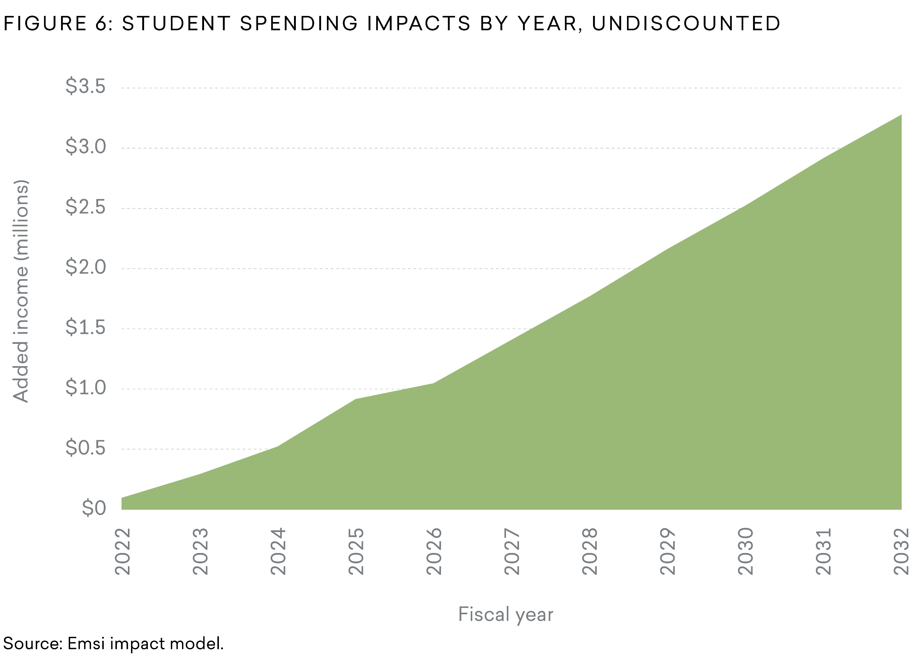
LONG-RUN STUDENT SPENDING IMPACT
FY 2022 – FY 2032
Relocated and retained student spending + ripple effects
Long-run student spending impacts by year, undiscounted
$15 million
Total added regional income
$3.3 million
Annual added regional income
(after stabilized)
All results measured in income, not sales. Results are net of counterfactual scenarios.

Slide 10

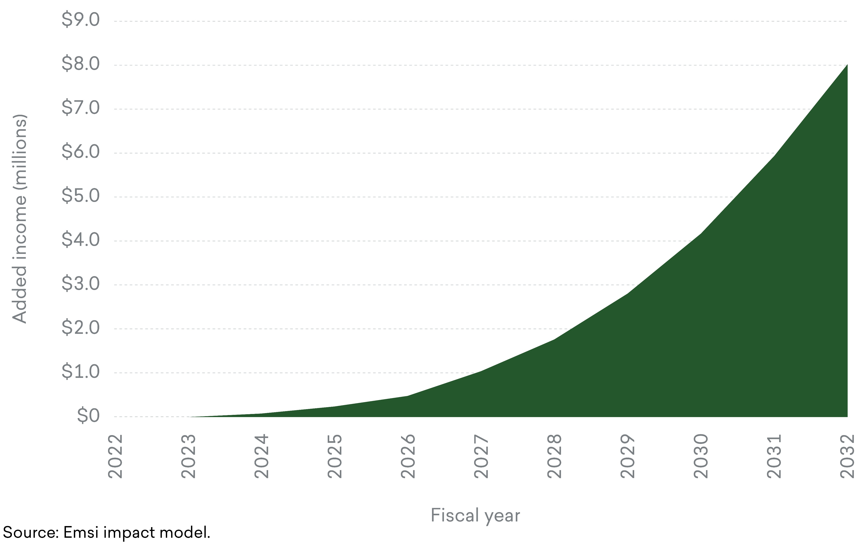
LONG-RUN ALUMNI IMPACT
FY 2022 – FY 2032
Higher alumni earnings and increased business profits + ripple effects
Long-run alumni impacts by year, undiscounted
$21.3 million
Total added regional income
$8.1 million
Annual added regional income
(after stabilized)
All results measured in income, not sales. Results are net of counterfactual scenarios.

Slide 11
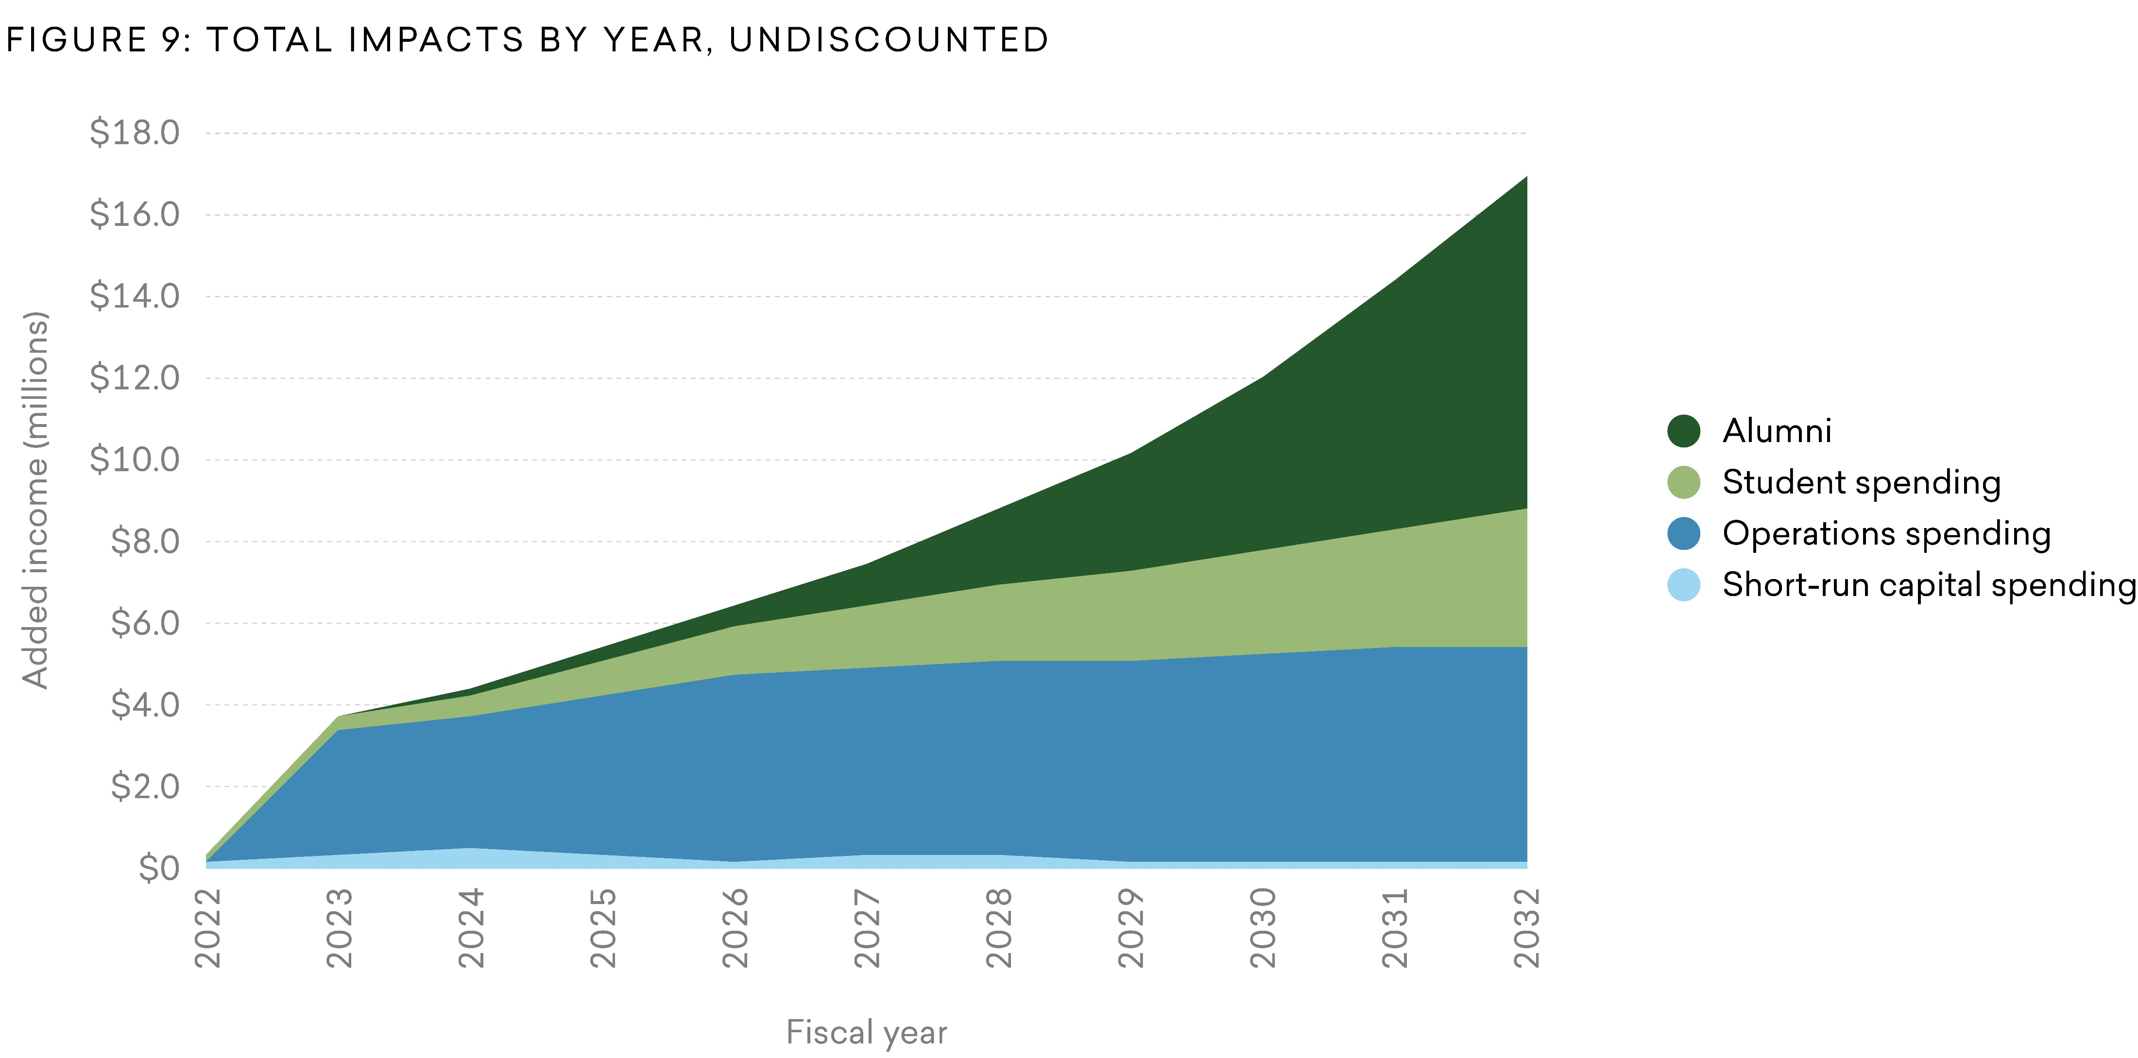

ECONOMIC IMPACT ANALYSIS
Total Impact from FY 2022 to FY 2032
$16.7 million
$78.5 million
in total income added in the NUMS
Annual income added in the NUMS (once stabilized)
OR
Total regional impact from FY 2022 to FY 2032, undiscounted
270
Jobs supported in the NUMS every year
OR
2.9 years
Capital spending and operations costs completely recovered
OR
$5.98
Created in added income from every $1 in funding

Slide 12

RETURN ON INVESTMENT FOR THE NUMS
$1.2 million capital investment from local taxpayers
$4.2 million
Added tax revenue (present value)
3.5
Benefit-cost ratio
26.4%
Annual internal rate of return
2.5
Return on investment

Slide 13

ENROLLMENT SENSITIVITY ANALYSIS
Extent to which outputs are affected by changes in predicted input data
$78.5 million
Base case:
Total income added to the NUMS
Present value of total economic impacts from FY 2022 to FY 2032 at a 10% and 20% increase in operations spending, student spending, and alumni variables:
10%
20%
$86 million
$93.6 million
Total income added to the NUMS
Total income added to the NUMS

Slide 14

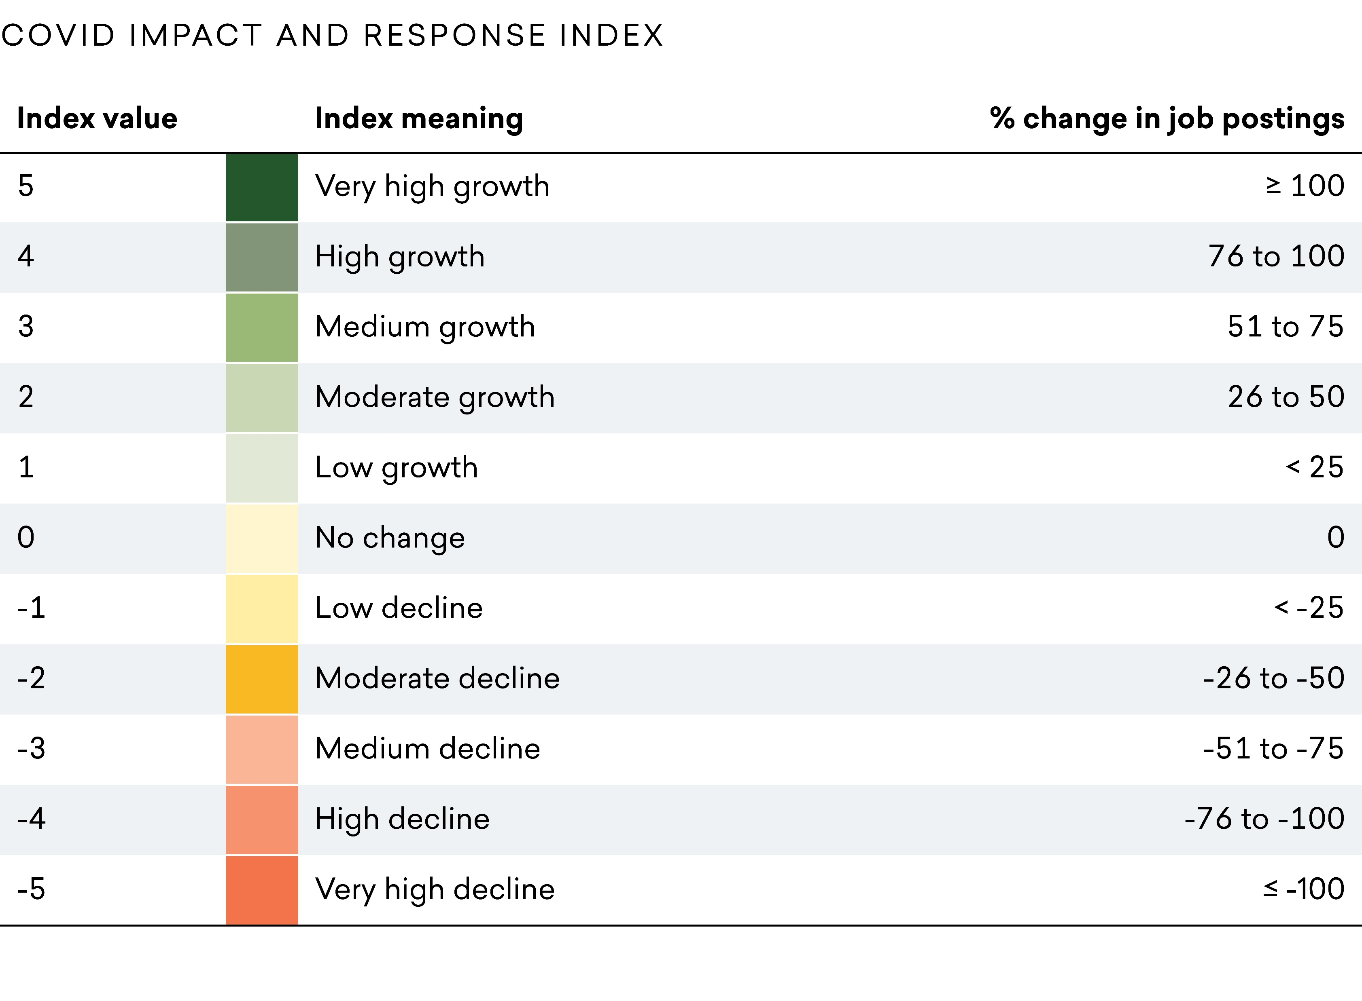
THE EFFECT OF COVID-19 ON PROPOSED PROGRAMS

Slide 15
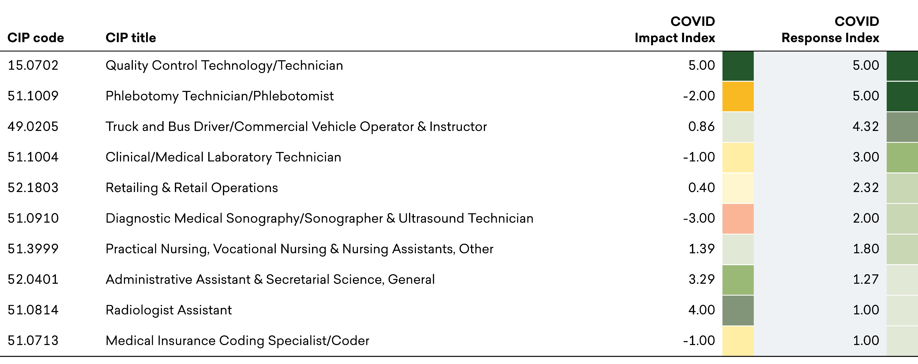
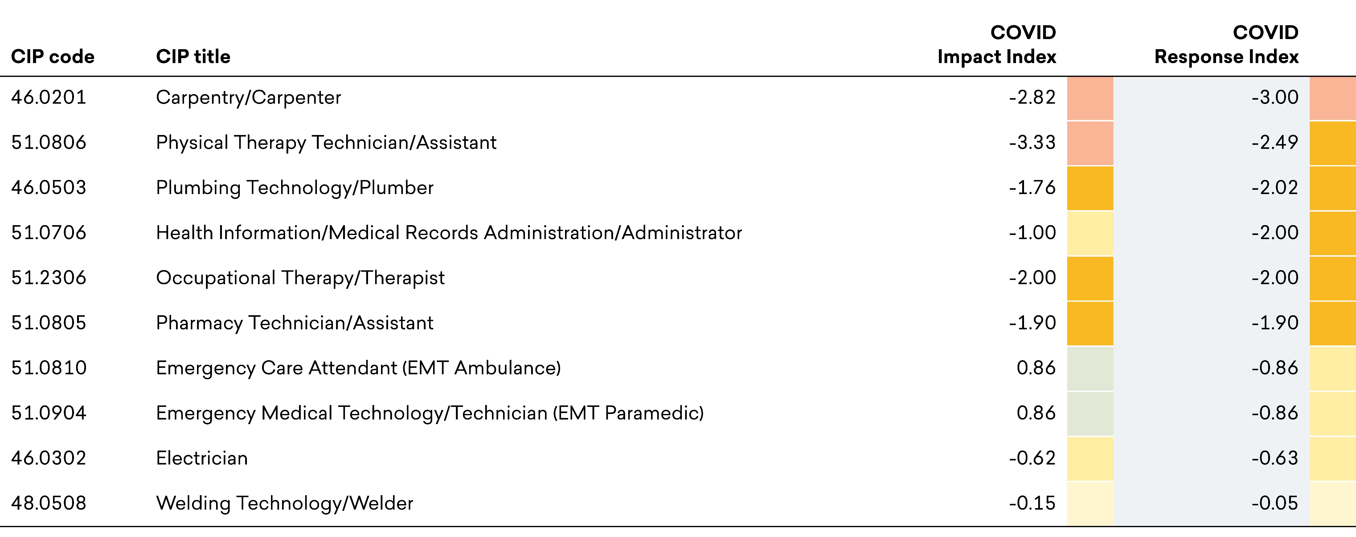
THE EFFECT OF COVID-19 ON PROPOSED PROGRAMS
Top 10 Proposed Programs with the Highest COVID Response Index
Top 10 Proposed Programs with the Lowest COVID Response Index

Slide 16
Next Steps
Send the executive summary to state legislators.
Share results with state & local media.
Use campus fliers, newsletters, websites, and social media to publish results.
Leverage impacts for proposals, grant writing, & strategic planning.
HOW CAN EMSI HELP?
Ongoing presentations from your Emsi economist
Email/call us anytime

Slide 17
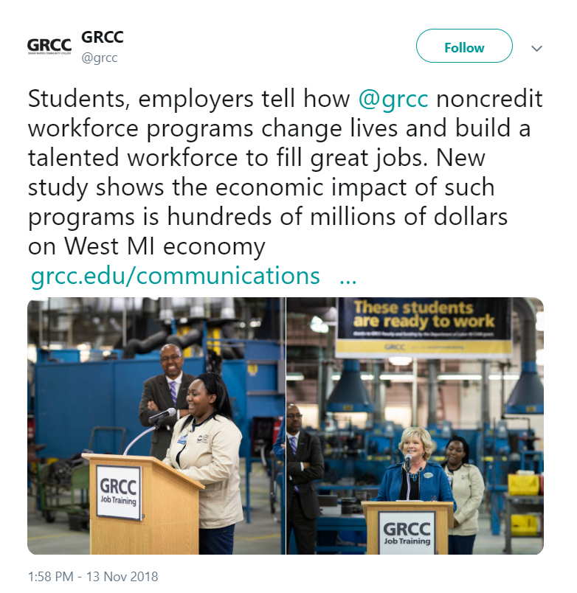

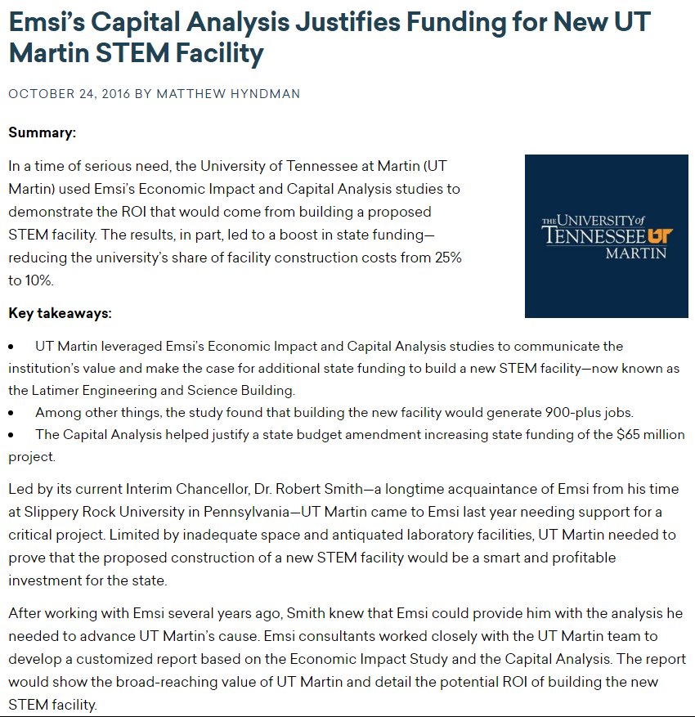
Share your results
Create a press release or hold a press conference to share results with your state and local media.
Include your results in your periodic publications.
Use your study to help secure additional funding.

Slide 18

The results of this study were prepared by
For a copy of the report, please contact the University of Houston.

