Slide 1
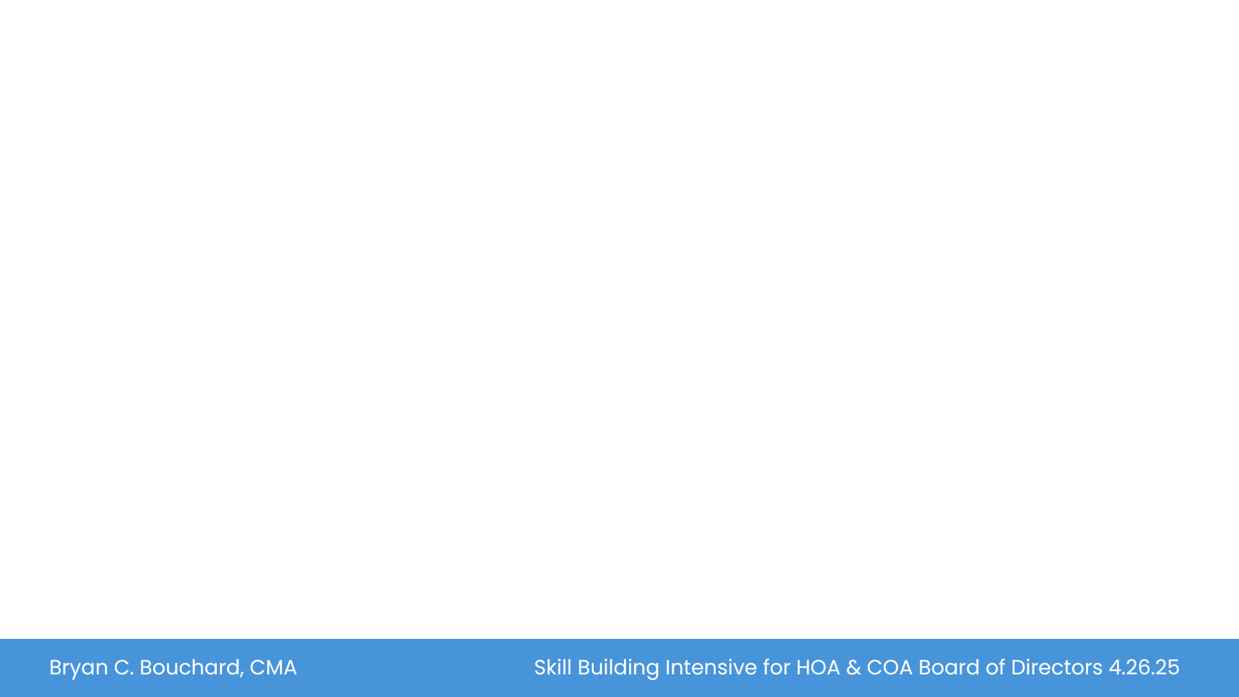

Key Topics
FINANCIAL MANAGEMENT
Bryan C. Bouchard, CMA
Balance Sheet
Income Statement
Reserve Management and Planning
The Budget
Operating and Reserve Accounts
Bid Management
$
$
$
$
$

Slide 2
Why is Financial Management So Important?
Governing a condo association is an important role
You will hear about legal aspects this morning
My experience

Slide 3
Board of Directors
Fiduciary Responsibility
Key Responsibilities
  Approving budgets
  Manage common areas – funding, maintenance & improvement
  Protecting association against loss (insurance & avoidable legal actions)
  Engaging community “Agent”
  Making & amending Rules & Regs (affecting quality of living)
Notes:
Key Points: Board members, as individuals can’t engage any vendor or management actions without Board Agreement; Board President has no more authority than a “member at large”; That said, there should be a collaborative relationship with vendors/management in particular where all parties are working together for the common good. Engagement of the “Agent” during BOD meetings and during projects to discuss progress and get BOD input
Avoidable legal includes a focus on transparency.

Slide 4
Understanding Financials
You don’t have to be an accountant – but you should have a basic understanding of the financials you will see.
I want to talk about items you should pay close attention to
In your packet is a sample set of financial documents
Balance Sheet
Income Statement
Budget
Notes:
Key Points: Board members, as individuals can’t engage any vendor or management actions without Board Agreement; Board President has no more authority than a “member at large”; That said, there should be a collaborative relationship with vendors/management in particular where all parties are working together for the common good. Engagement of the “Agent” during BOD meetings and during projects to discuss progress and get BOD input
Avoidable legal includes a focus on transparency.

Slide 5
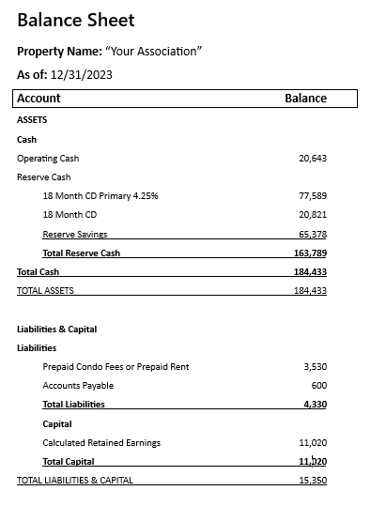
The Balance Sheet
It reports on the Assets and Liabilities of the Association
Refer to the Balance Sheet in your packet.
Notes:
Refer to Balance Sheet in the packet; Highlight Balance Sheet reflect a ”Point in Time” of Association's assets and liabilities; Balance Reserve liquidity when planning for CD investments

Slide 6
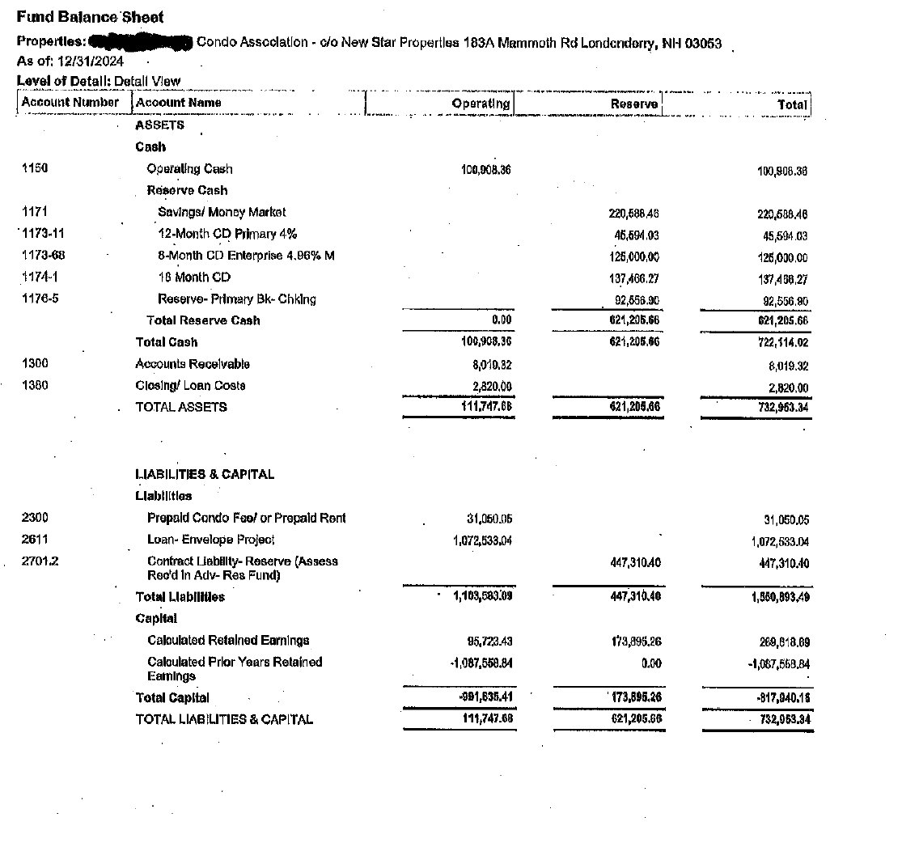

Slide 7
The Balance Sheet
Notice Separation of Operating & Reserve Accounts
  Operating Account – pays routine bills & receives fees
  Reserve Account – funded to pay for long term replacement assets
Cash Balance
  “Rule of Thumb” – 1 month’s expenses (essentially, working capital)
Notes:
Refer to Balance Sheet in the packet; Highlight Balance Sheet reflect a ”Point in Time” of Association's assets and liabilities; Balance Reserve liquidity when planning for CD investments

Slide 8
The Balance Sheet
Accounts Receivable – (past due collections)
  Know your Board’s policy for collection
Reserve Balance
  How does it compare to Reserve Study forecast?
  Are long term funds earning reasonable interest?
Notes:
Refer to Balance Sheet in the packet; Highlight Balance Sheet reflect a ”Point in Time” of Association's assets and liabilities; Balance Reserve liquidity when planning for CD investments

Slide 9

Bank Statement /
Bank Reconciliation
You should find this info in your board packet each month
Examine the bank statement closely
Look at the bank reconciliation
Notes:
I edited the text in gold to be clear – pls review it

Slide 10
Why Look at the
Bank Statement and
Bank Reconciliation?
This is a good system of internal control
Note: Internal control refers to the policies and procedures put in place to protect the assets of the organization from theft or error
You can uncover a lot from these documents

Slide 11

The Income Statement
  Presents income and expense activity for a specific period (typically monthly)
  NOTE: There is an Income Statement for the Operating account and one for the Reserve account
    Loan repayments are NEVER considered “Reserve Contribution”
    Reserve contributions are for future projects; not projects already acquired

Slide 12
The Income Statement
Understanding How It Works
Look for Key Variances
  What’s driving favorable/unfavorable expenses?
  Real spending drivers – Why?
  Timing? (i.e., insurance premiums are uneven)
  Budgeting problem or oversight?
Notes:
Refer to Handout illustration for Income Statement

Slide 13
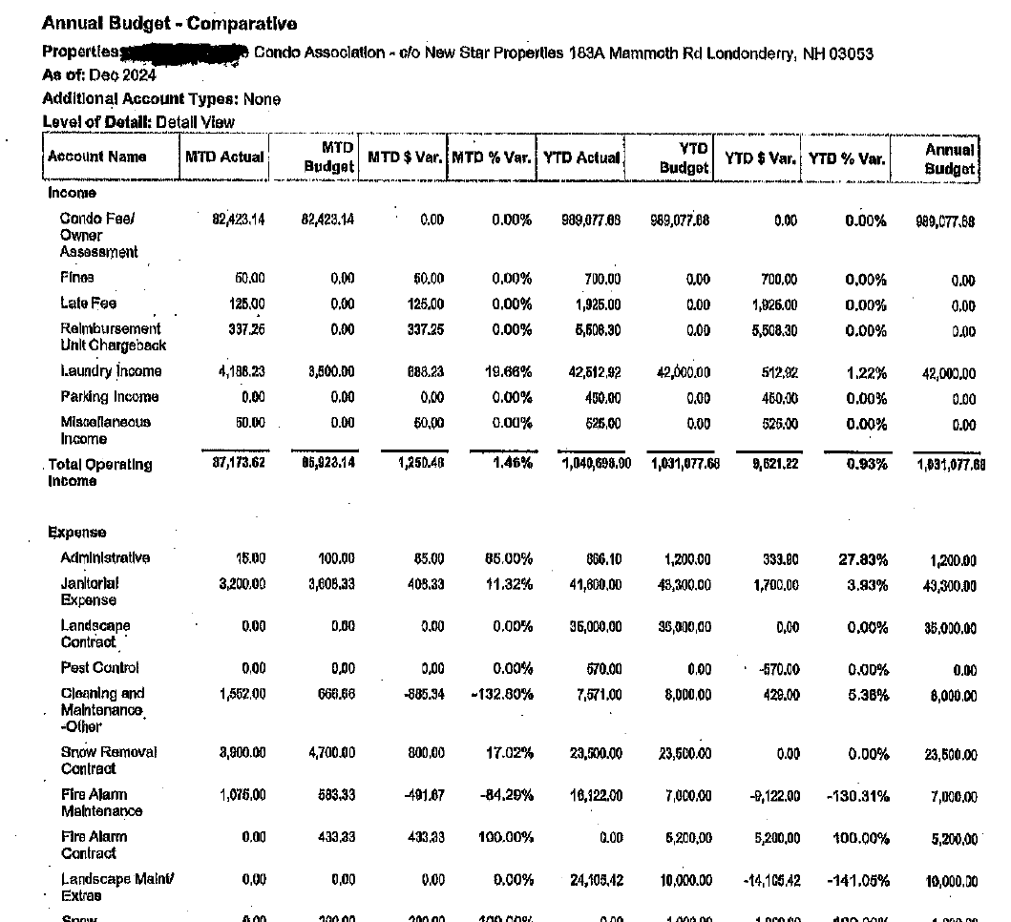

Slide 14
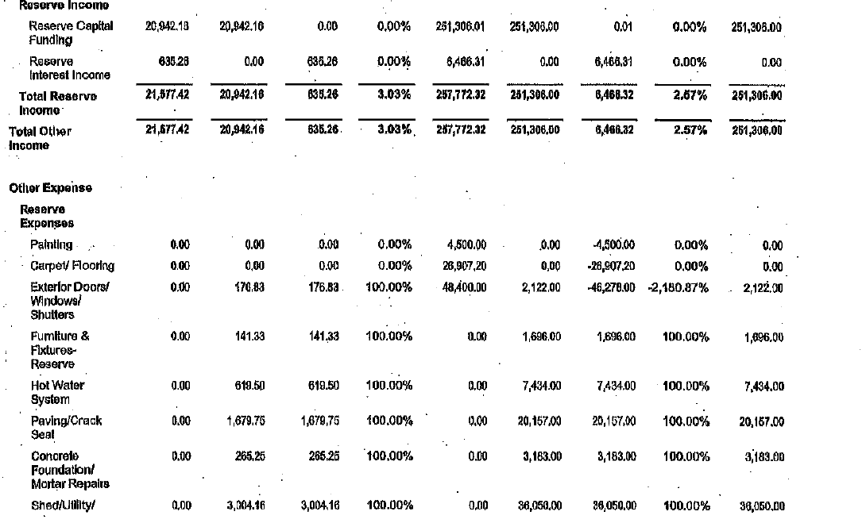

Slide 15
Financial Sustainability
The Direct Link to Reserve Planning
Financial sustainability depends on “data driven” planning
  Rule of Thumb – No connection to reality
    FHA minimum requirements “10% of income”
  Back of the envelope self-developed spreadsheets
    No Substitute for the Reserve Study
  Reserve Study establishes funding for YOUR unique requirements
Notes:
Refer to handout of Balance Sheet.

Slide 16
Reserve Study
Catalogs All Capital Assets
  Establishes remaining useful life
  Projects replacement costs per asset
  Recommends annual funding contribution and replacement schedule
  Forecasts replacements over 30-40 cycles to capture long life items such as siding, paving, roofing
  Updated every 3-5 years
Approximate estimates – not decimal point accurate
Notes:
Discuss % of Fully Funded;- ~65%-75% Very adequate; 25% or less, high exposure to special assessment; Show Shaker Reserve Study

Slide 17

The Reserve Study
and Money Appropriation
Capital Assets
  Typically replaced infrequently ~5-30 years
  Roofs, paving, septic pumps, etc.
“Grey Area Assets”
  Seal coating
  Extensive rot repair
  Cyclical exterior painting
If the “grey area” assets are provided for in the Reserve Study; replacements are legitimate reserve expenses
Reserve funds should not be accessed just because operating funds are low

Slide 18
The Reserve Study and Money Appropriation
Generally, if the Reserve Study provided for a specific asset replacement, appropriating funds is appropriate
Example – roof replacement is forecast for 2027; but requires replacement in 2025, legitimate to pull funds
Example - if significant rot repair is required but no funding provision made through Reserve Study
  Rot should be addressed through Operating Account
  If pulled as an “unfunded” component from the Reserve Study, recognize that this component should be added in the next 5 year update. Reserve contribution recommendation will increase due to new component and backfilling a prior year appropriation from which there were no funds provided

Slide 19

Funding Choices When Reserves Run Out
Crises management results when capital projects can not be funded through Reserves
No good options, but…
Special Assessment OR a Bank Loan

Slide 20
Funding Choices When Reserves Run Out
Special Assessment
Can be very difficult to collect due to exceptional strain on homeowners
“Flags” potentially weak financial management to banks and future buyers
SHOULD NOT be used to fund recurring capital or operating expenses
Bank Loan
Short term, relatively painless solution; but…
Encumbers future association income
Debt service years after project was completed
By the time you pay off the loan the assets may need to be replaced again!

Slide 21

The Budget
Translating Plans & Strategies to Reality!
Actually, Two Budgets
  Operating & Reserve
Be Transparent
  Review Budget Draft at Open Meeting; Allow Comments Before & After
Be Real!
  Best Estimate on Expenses (not necessarily “Best Case”)
Provide for the Unexpected Contingency
  Create an Operating Contingency Fund Target?

Slide 22
The Budget
Funding Capital Projects
Capital Projects Should be Funded Through Accumulated & Planned Reserves
  Hard decisions on catch up contributions - sometimes must be made to stop cyclical crises funding management
  Sometimes dues must increase to fill in for short sighted decisions of the past
  Loans
  Special Assessments
Notes:
The Board is not leading a convoy which travels at the pace of the slowest vehicle.

Slide 23
The Budget
Funding Capital Projects
Financial Management
Board’s Fiduciary Responsibility is to Community
Budget and funding decisions must be made in community’s best interest recognizing some members may need to consider other living locations for budget reasons.
Notes:
The Board is not leading a convoy which travels at the pace of the slowest vehicle.

Slide 24
Managing Cash
Cash is king!
Your operating budget and capital budget flow into the cash budget!
Need to manage cash so you don’t have any unexpected cash flow issues

Slide 25

What Does Good Bid Management Look Like?

Slide 26
Should Everything or Nothing Go to Bid?
Factors to Consider
Size of the investment?
  Is it $300 mower; or, a $7,000 lighting upgrade?
Type of Project & Community History
  Totally new endeavor?
  Bids can help validate scope
  A repeat project (i.e. power washing) with historical experience?
    Historical cost reference
    Good vendor experience
Notes:
Additional bids on mower likely will cost more to develop than any gain on pricing.
Working with bids will help to promote ideas about a given project and assist with scope definition. Good, loyal contractors that are fair and provide excellent service are ones we want to keep!

Slide 27

Bid Process
Establish scope of work
  Or, finalize scope based on vendor input for complex projects
Depending on scope of work
  2-3 vendors
Contract after validating COI (Cert of Insurance)
Supervise/validate quality delivery
Notes:
Scope is generally effected by historical data, committees (landscape), management company and BOD input.

Slide 28

IRS Statement
Revenue Ruling 70-604
The purpose of 70-604 is to allow HOAs that have excess income (assessment and fees exceeding expenses) in a specific year to refund that excess income to the members or roll it over to the next year to avoid being taxed on any excess income. The ruling allows an HOA to make an election that will essentially defer the excess income for the year to the subsequent year.

Slide 29

Financial Compilation, Review vs Audit
Often associations will hire a CPA firm to do a compilation and review of the association’s financials
Know the difference between each of these
Often there is confusion on these
Notes:
Do you want to add a slide to differentiate them?

Slide 30
Summary
Financial Management of a condo association is one of the most crucial and important tasks you will have as a board member
Often when you have unhappy owners being able to show them through the financials why condo fees are where they are helps get them to better understand

Slide 31
Questions
Happy to answer any questions you may have
Feel free to reach out
I can be reached at Bryan.Bouchard@gmail.com or 603-661-3560

