Slide 1

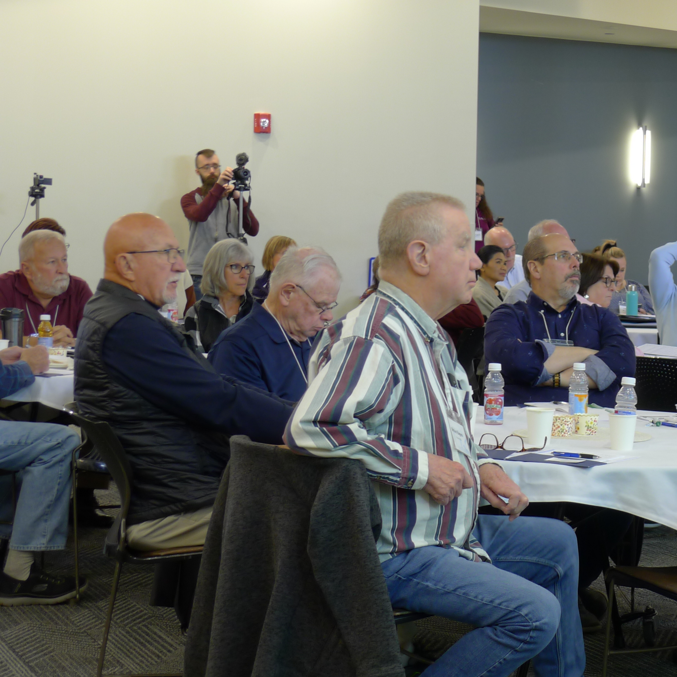



Welcome!
Skill Building Intensive for HOA & COA
Board of Directors
Presented by New Star Properties, a Trademark of Realty Management Partners
2025

Slide 2

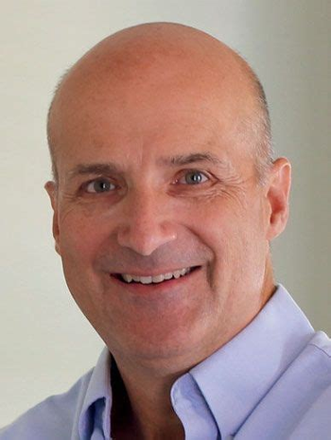
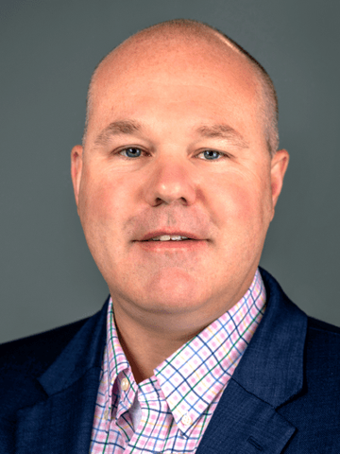
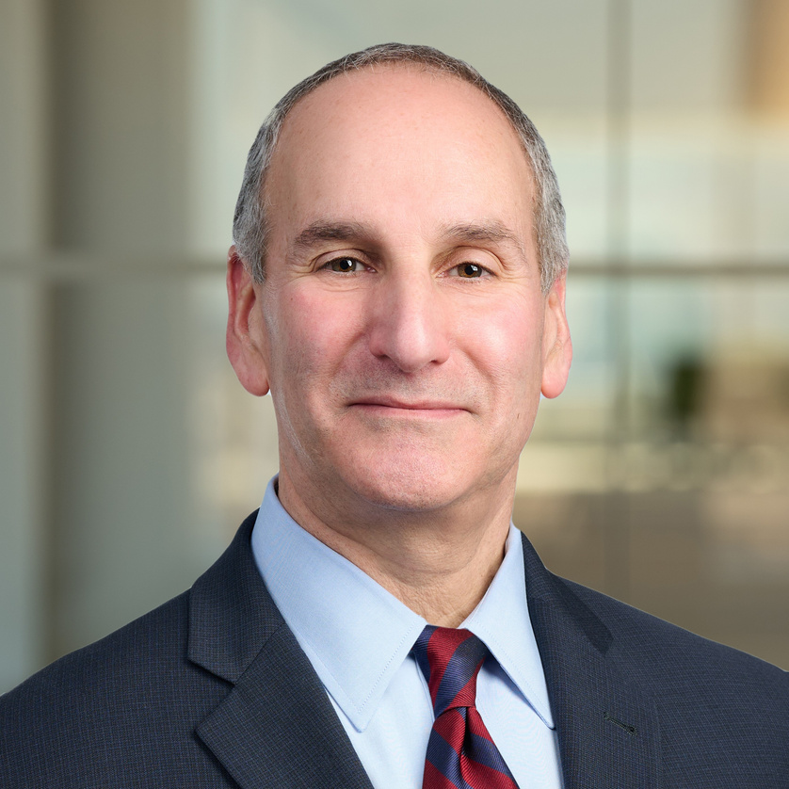
TODAY’S SPEAKERS
TIM WEGE
BRYAN BOUCHARD
MICHAEL R. FENIGER
New Star Properties
SNHU Accounting Faculty
Easter Seals Chair
Feniger, Uliasz & Stacey
New Star PropertiesTM
Skill Building Intensive for HOA & COA Board of Directors 4.26.25

Slide 3

SEMINAR TOPICS
1
INTRODUCTIONS
4
ROLES & RESPONSIBILITIES
2
THE RESERVE STUDY
MECHANICS & APPLICATIONS
5
GOVERNANCE & BEST PRACTICES
3
FINANCIAL MANAGEMENT
CONFLICT MANAGEMENT & FINDING RESOLUTION
6
New Star PropertiesTM
Skill Building Intensive for HOA & COA Board of Directors 4.26.25

Slide 4
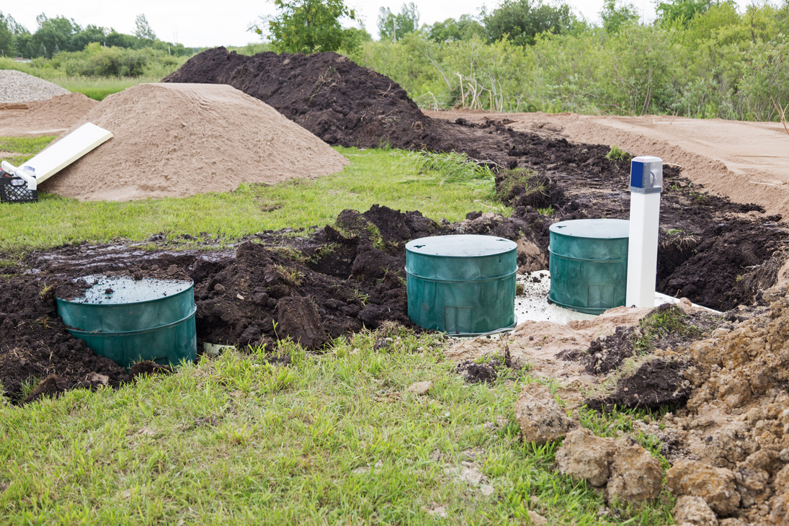



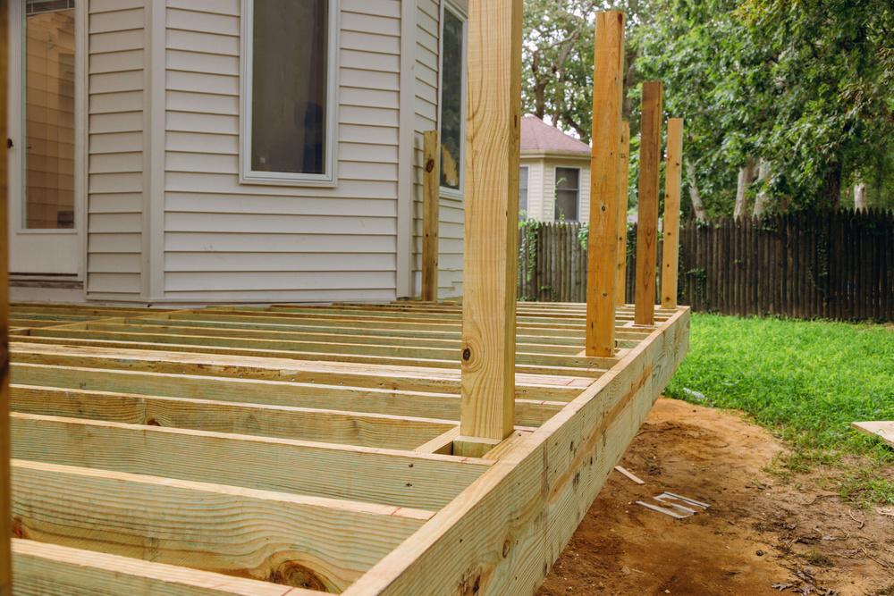
CENTRAL TO LONG TERM FINANCIAL SUSTAINABILITY
Prepare for the replacement of long life, big ticket, replacement expenses
Roofs, Siding, Decks, Porches, Septic Fields, Septic Lift Pumps, Clubhouse, Pools, Wells, Driveways, Streets, Street Lights, Signage
New Star PropertiesTM
Skill Building Intensive for HOA & COA Board of Directors 4.26.25

Slide 5

PLANNING FOR CAPITAL REPLACEMENTS
Commonly Seen “Strategies”
New Star PropertiesTM
Skill Building Intensive for HOA & COA Board of Directors 4.26.25

Slide 6

PLANNING FOR CAPITAL REPLACEMENTS
We did “this amount last year” and we’re adding $10,000 more this year?
Common Strategy No. 1
New Star PropertiesTM
Skill Building Intensive for HOA & COA Board of Directors 4.26.25

Slide 7
PLANNING FOR CAPITAL REPLACEMENTS
Banks like to see X% of collected condo fees?
Common Strategy No. 2
New Star PropertiesTM
Skill Building Intensive for HOA & COA Board of Directors 4.26.25

Slide 8

PLANNING FOR CAPITAL REPLACEMENTS
We need
(roof? paving? siding?) within the next 5 years.
We’ll fund “for that”
Common Strategy No. 3
New Star PropertiesTM
Skill Building Intensive for HOA & COA Board of Directors 4.26.25

Slide 9
PLANNING FOR CAPITAL REPLACEMENTS
We have $X amount in Reserves. That seems like a lot?
Common Strategy No. 4
New Star PropertiesTM
Skill Building Intensive for HOA & COA Board of Directors 4.26.25

Slide 10
PLANNING FOR CAPITAL REPLACEMENTS
We’re a new community; No replacements needed for at least 10 years?
Common Strategy No. 5
New Star PropertiesTM
Skill Building Intensive for HOA & COA Board of Directors 4.26.25

Slide 11

HOW DID THAT WORK OUT FOR YOU?
TELL TALE SIGNS OF PLANNING GAPS
LOANS
Eases the “pain of the moment”; but, lingers well beyond installation
New Star PropertiesTM
Skill Building Intensive for HOA & COA Board of Directors 4.26.25

Slide 12
HOW DID THAT WORK OUT FOR YOU?
TELL TALE SIGNS OF PLANNING GAPS
SPECIAL ASSESSMENTS
  “Something” took us by surprise and we did not have funds to address the problem
  Can produce a financial crises
  What happens if several unit owners cannot make the payment?
New Star PropertiesTM
Skill Building Intensive for HOA & COA Board of Directors 4.26.25

Slide 13

RESERVE STUDY
CONDO MANAGEMENT 101
  “Data Driven” Analysis of Community Capital Assets
  Projects Replacement Values and Timing
  Recommends Funding Strategies
  Answers the Question:
    How Much Should the Community Put in Reserves?
New Star PropertiesTM
Skill Building Intensive for HOA & COA Board of Directors 4.26.25

Slide 14

RESERVE STUDY
CONDO MANAGEMENT 101
“Data Driven” Analysis of Community Capital Assets
New Star PropertiesTM
Skill Building Intensive for HOA & COA Board of Directors 4.26.25

Slide 15

RESERVE STUDY
CONDO MANAGEMENT 101
Projects Replacement Values and Timing
New Star PropertiesTM
Skill Building Intensive for HOA & COA Board of Directors 4.26.25

Slide 16

RESERVE STUDY
CONDO MANAGEMENT 101
Recommends Funding Strategies
New Star PropertiesTM
Skill Building Intensive for HOA & COA Board of Directors 4.26.25

Slide 17


RESERVE STUDY
CONDO MANAGEMENT 101
Answers the Question:
How Much Should the Community Put in Reserves?
New Star PropertiesTM
Skill Building Intensive for HOA & COA Board of Directors 4.26.25

Slide 18
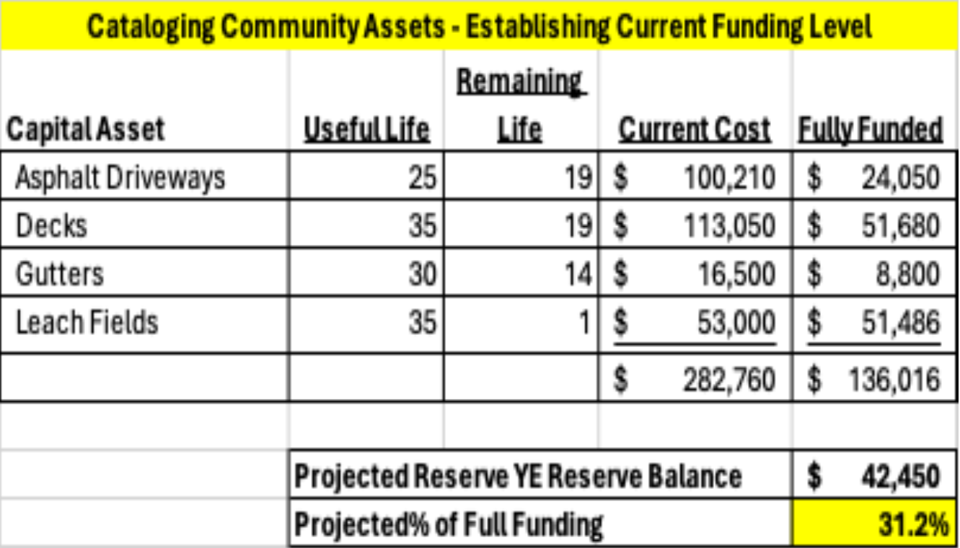
CATALOGUE ASSETS
ESTABLISH CURRENT FUNDING
LEVELS
NewStarPropertiesTM
Skill Building Intensive for HOA & COA Board of Directors 4.26.25

Slide 19
PROJECT FUTURE CAPITAL
OUTFLOWS AND FUNDING PERCENTAGES
  See Projection Handout (3 pages)
  Understand Implications of Funding Percentages
0-25% Critical, High Crisis Probability
26%-65% FAIR, Crises Potential Lessens
65% + GOOD, Low Probability, Long Term Health
NewStarPropertiesTM
Skill Building Intensive for HOA & COA Board of Directors 4.26.25

Slide 20
  10 Year Old Community; 56 units
  1st Reserve Study Completed in 2024
  Historic Reserve Contribution Numbers Set Arbitrarily (and too low!)
  Reserve Study Recommends a Minimal Increase of $70,000/year (~$104/unit/month)
  What Are Your Options? Pros & Cons?
CASE STUDY
Dealing With Data Showing Increases Are Necessary
NewStarPropertiesTM
Skill Building Intensive for HOA & COA Board of Directors 4.26.25

Slide 21

You Are Protecting Total Community Asset Values of (# of Units * Avg Selling Price) = 10’s of Millions
Data Driven Analysis Equips You to Manage Reality
Funding Options (particularly “catch up”) are Not Easy, but Essential to Community Health
Compare Year End Reserve Fund to Study Recommendations – Are You Tracking?
Update at Least Every 5 Years
TAKE AWAY POINTS
NewStarPropertiesTM
Skill Building Intensive for HOA & COA Board of Directors 4.26.25

